Slide 1

Department of BES-II
BASIC ELECTRICAL & ELCTRONIC CIRCUITS (BEC)
COURSE CODE : 23EC1203
Topic:
AC Fundamentals: rms and average values
Session – No. 2

Slide 2



AIM OF THE SESSION
To familiarize students with the basic concept of AC fundamentals: RMS and Average Values
INSTRUCTIONAL OBJECTIVES
This Session is designed to:
Describe AC and DC Signals
Demonstrate Parameters of AC signals
List out the differences between AC and DC signals
Describe How to calculate RMS and Average values of a given wave
Describe the response of R, L and C for AC signals
LEARNING OUTCOMES
At the end of this session, students should be able to:
Describe AC and DC Signals
Define Average and RMS values
Summarize differences between AC and DC Signals
Calculation of reactance and impedance.

Slide 3
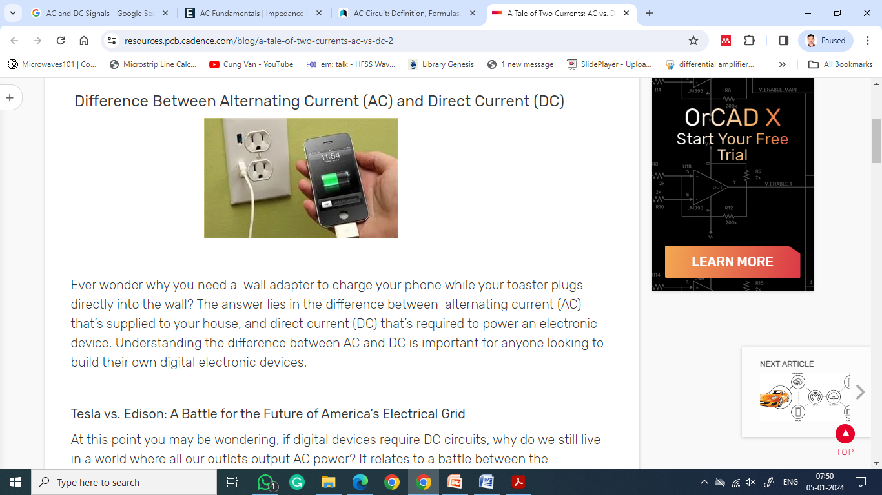
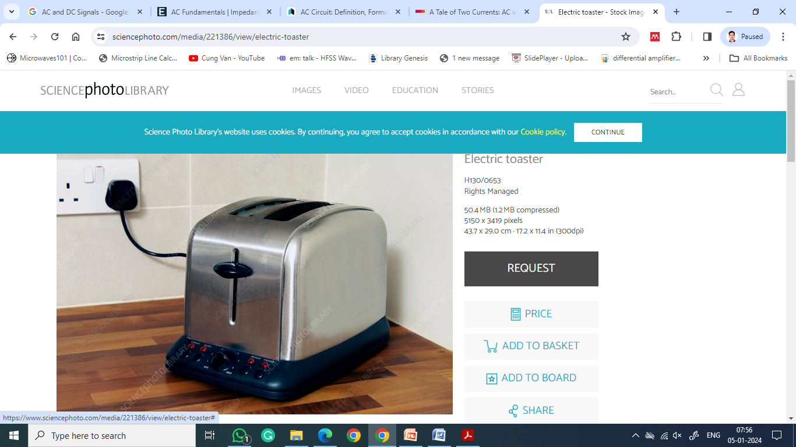
INTRODUCTION
Do you ever wonder why we need a wall adapter to charge our phone while the toaster plugs directly into the wall?
The answer lies in the difference between alternating current (AC) that’s supplied to your house, and direct current (DC) that’s required to power an electronic device.
AC and DC are also used when referring to voltages and electrical signals which are not currents.

Slide 4
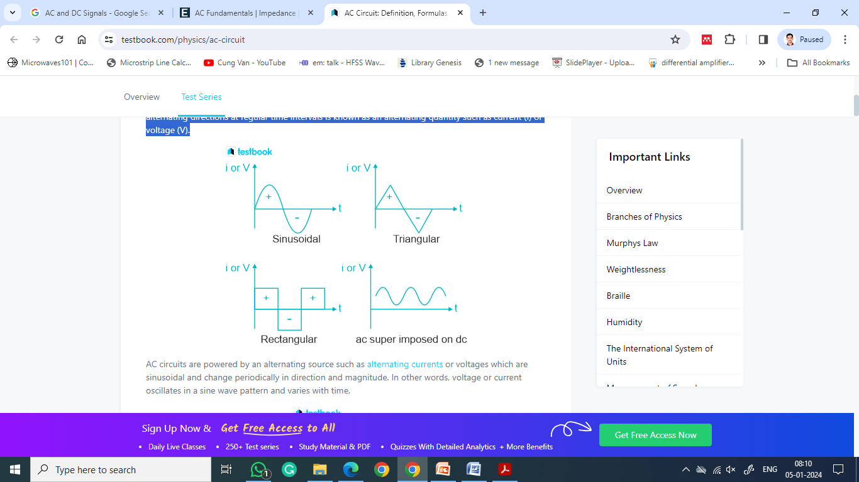
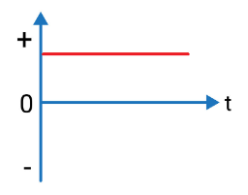
INTRODUCTION
AC Signal:
The quantity that changes continuously in magnitude
between zero and a maximum value with alternating
directions at regular time Intervals is known as
alternating signal such as current (I) or voltage (V).
DC Signal:
The quantity that may change in magnitude but not the direction is known as DC signal.

Slide 5
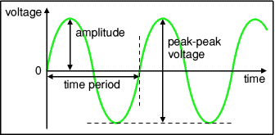
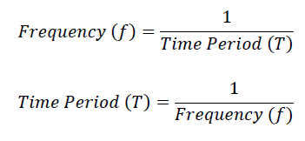

PROPERTIES OF AC SIGNALS
Amplitude: It is the maximum value reached by the signal. Also known as peak value.
Peak-to- Peak value: It is twice the peak value.
Time period (T): It is the time taken for the signal to
complete one cycle. It is measured in seconds (s).
Frequency (f): It is the number of cycles per second.
It is measured in hertz (Hz).

Slide 6
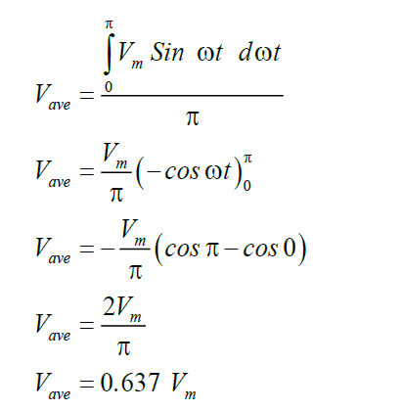
AVERAGE AND RMS VALUES
Average value:
It is defined as the average of all instantaneous value
of alternating quantities over a half cycle.
Vavg = Average value of voltage
Iavg = Average value of current
Finding average value of sine wave:

Slide 7
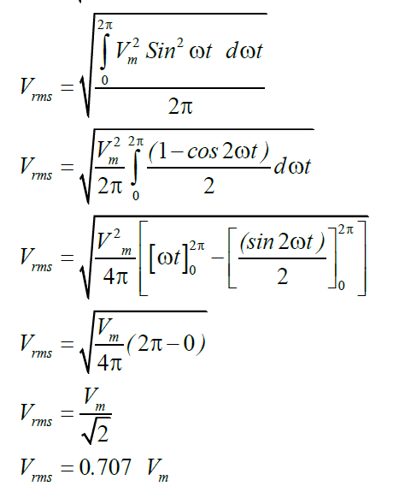
AVERAGE AND RMS VALUES
Root Mean Square (RMS) Value:
It is the equivalent dc current which when flowing through
a given circuit for a given time produces same amount
of heat as produced by an alternating current when
flowing through the same circuit for the same time.
Vrms =RMS value of voltage
Irms = RMS value of current

Slide 8

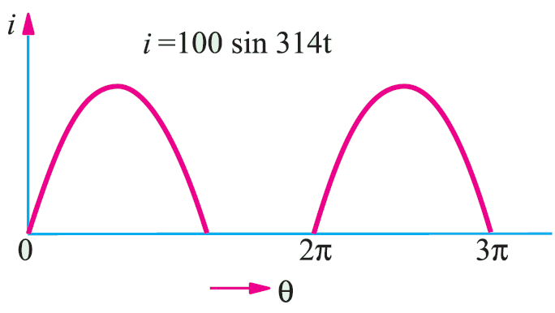
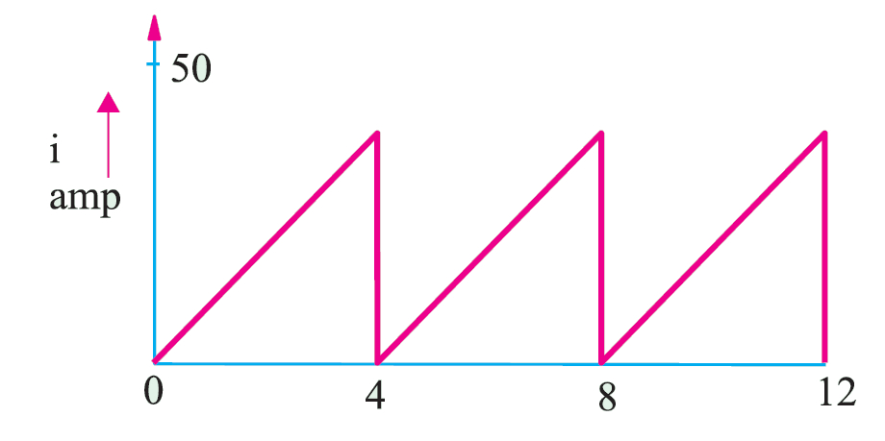
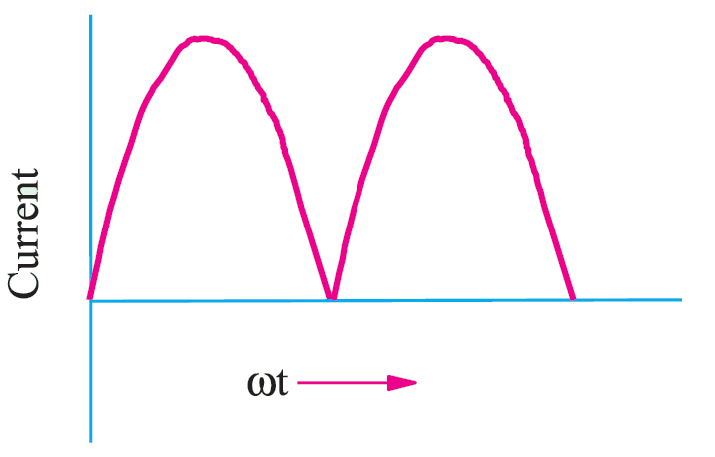
EXAMPLES
Find average and RMS values of the following given waveform

Slide 9
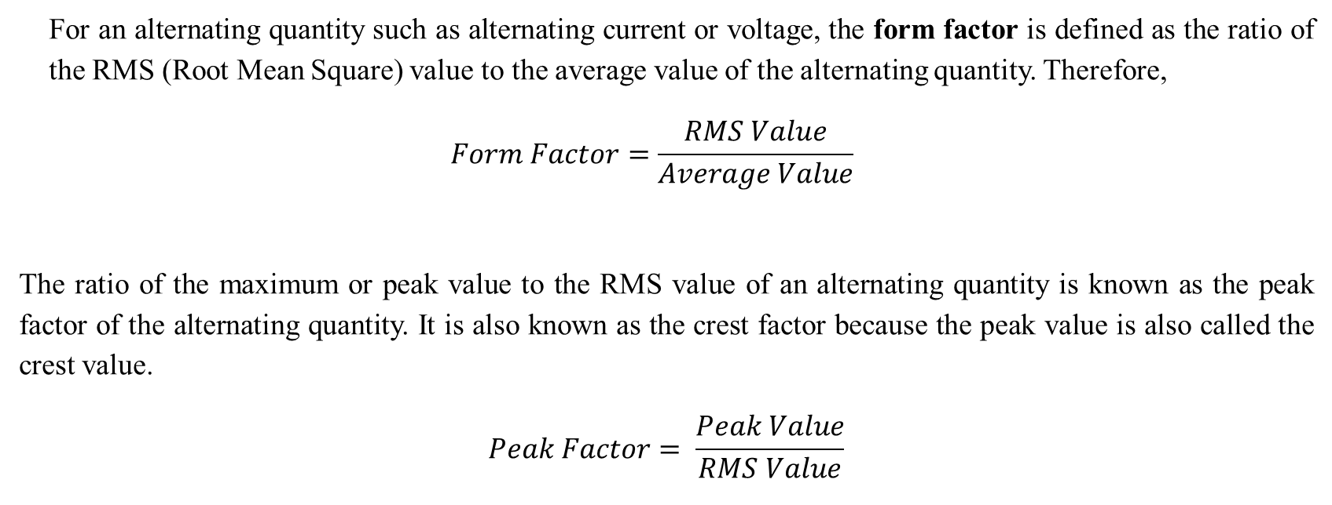
Form Factor and Peak Factor
For an alternating quantity such as alternating current or voltage, the form factor is defined as the ratio of the RMS (Root Mean Square) value to the average value of the alternating quantity. Therefore,
$$Form Factor=\frac{RMS Value}{Average Value}$$
The ratio of the maximum or peak value to the RMS value of an alternating quantity is known as the peak factor of the alternating quantity. It is also known as the crest factor because the peak value is also called the crest value.
$$Peak Factor= \frac{Peak Value}{RMS Value}$$

Slide 10
A.C. Through R, L & C
AC through Resistance
AC through Inductance
AC through Capacitance

Slide 11
SELF-ASSESSMENT QUESTIONS
Alternating current cannot be measured by D.C ammeter because
D.C ammeter get damaged
Average value of current over a complete cycle is zero
A.C cannot pass through D.C ammeter
A.C changes directions periodically
In alternating current, the direction and magnitude of the current varies
Randomly
Periodically
Exponentially
Do not vary

Slide 12
SELF-ASSESSMENT QUESTIONS
7. Which waveform is likely to have the highest peak factor?
Sine wave
Square wave
Triangular wave
Sawtooth wave
8. If the peak value of a sinusoidal waveform is 10 V, what is the RMS value?
5V
7.07 V
10 V
14.14 V

Slide 13
SELF-ASSESSMENT QUESTIONS
9. What is the form factor of a square wave?
1.0
0.707
1.414
2.0
10. If a waveform has a peak factor of 1.414, what is its form factor?
0.707
1.0
1.414
2.0

Slide 14
TERMINAL QUESTIONS
1. Describe different parameters of sinusoidal ac signal?
2. List out the differences between ac and dc circuits.
Analyze a symmetrical square wave signal having an amplitude of Am for its average
and RMS values.

Slide 15
REFERENCES FOR FURTHER LEARNING OF THE SESSION
Reference Books:
1. Mahmood Nahvi, Joseph Edminister - Schaum’s Outline of Electric Circuits-McGraw-Hill (2018)
2. John Bird - Electrical Circuit Theory and Technology-Routledge, Taylor & Francis Group (2022)
3. A. Sudhakar, Shyammohan, and S. Pallai - Circuits and Networks: Analysis and Synthesis-McGraw-Hill (2015)
Sites and Web links:
https://testbook.com/physics/ac-circuit
https://resources.pcb.cadence.com/blog/a-tale-of-two-currents-ac-vs-dc-2
https://testbook.com/physics/alternating-current

Slide 16
THANK YOU
Team – Fundamentals of IoT & Sensors

